Slide 1

infinity solutions
Sanoop Philip
22PMC148

Slide 2
ABSTRACT
Solutions Infinity clone is a web application that aims to replicate the core functionality and features of the popular question-and-answer platform, Stack Overflow. The features including signup, login, ask question, post answer, use tags, users profile, delete questions, delete answers etc. Users can post their queries and also answer others queries. It also includes powerful search capabilities to enable users to quickly find relevant questions and answers, thereby facilitating efficient knowledge discovery.Also included with powerfull Solutions Gpt.
The Existing System were Developers relied on mailing lists, forums, and online communities specific to programming languages or technologies to ask questions and get assistance.

Slide 3
This Stack Overflow clone offers an accessible and approachable platform for individuals, students, and professionals seeking knowledge exchange and technical assistance.
It provides a valuable resource for both beginners and experienced practitioners to grow their skills, find solutions to complex problems. To develop the Stack Overflow clone, a combination of front-end and back-end technologies were utilized, including HTML, CSS, JavaScript, Python, Django framework, and a relational database management system

Slide 4
REQUIREMENTS
User Registration and Authentication
Question and Answer System
Voting
Tagging
Reputation System
Notifications
Search Functionality

Slide 5
Features and highlights
Register as a user with tags selected.
User get question related to those tags, but user can filter questions according to tags they have selected.
User can search and ask new question.
User can view all solutions related to question.
user can add comment on questions if they have any doubt.
User can add solution.

Slide 6
Features and highlights
user can search question.
User can see all tags in system and see questions related to it.
Admin can view bar chart visualization of all users.
Admin can view line graph of questions asked and solution given.
User can use solutions gpt, if user don’t get solution from system.
User get notified if they get solution for their question.
User get reputation on basis of upvote, question and solution added

Slide 7
Third party libraries
Django-jazzmin: It provides a customizable and modern administration interface for Django applications.
Matplotlib: it provides a wide range of tools for creating various types of plots, charts, and graphs.
Open ai: An API for accessing new AI models developed by OpenAI.
Charts js: Chart.js is a popular open-source JavaScript library used for data visualization. It provides an easy way to create various types of charts, such as line charts, bar charts, pie charts, and more

Slide 8
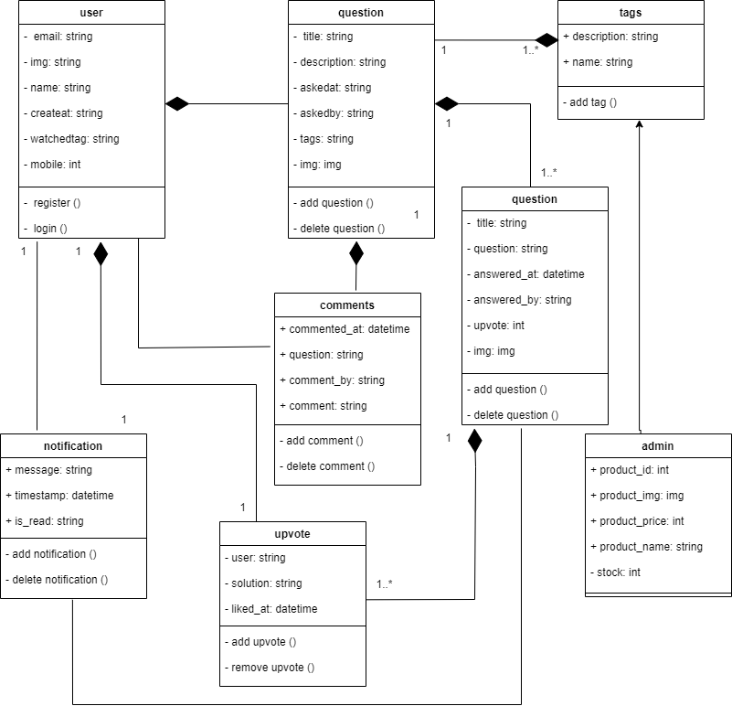
Class diagram

Slide 9
CHALLENGES FACED
It was difficult to implement a notification system.
Integrating chat gpt api to my solutions infinity.
Getting Admin Visualization of Bar chart of users according to there reputation needed some research work.
It required more time for providing line graph of questions asked and solution.

Slide 10
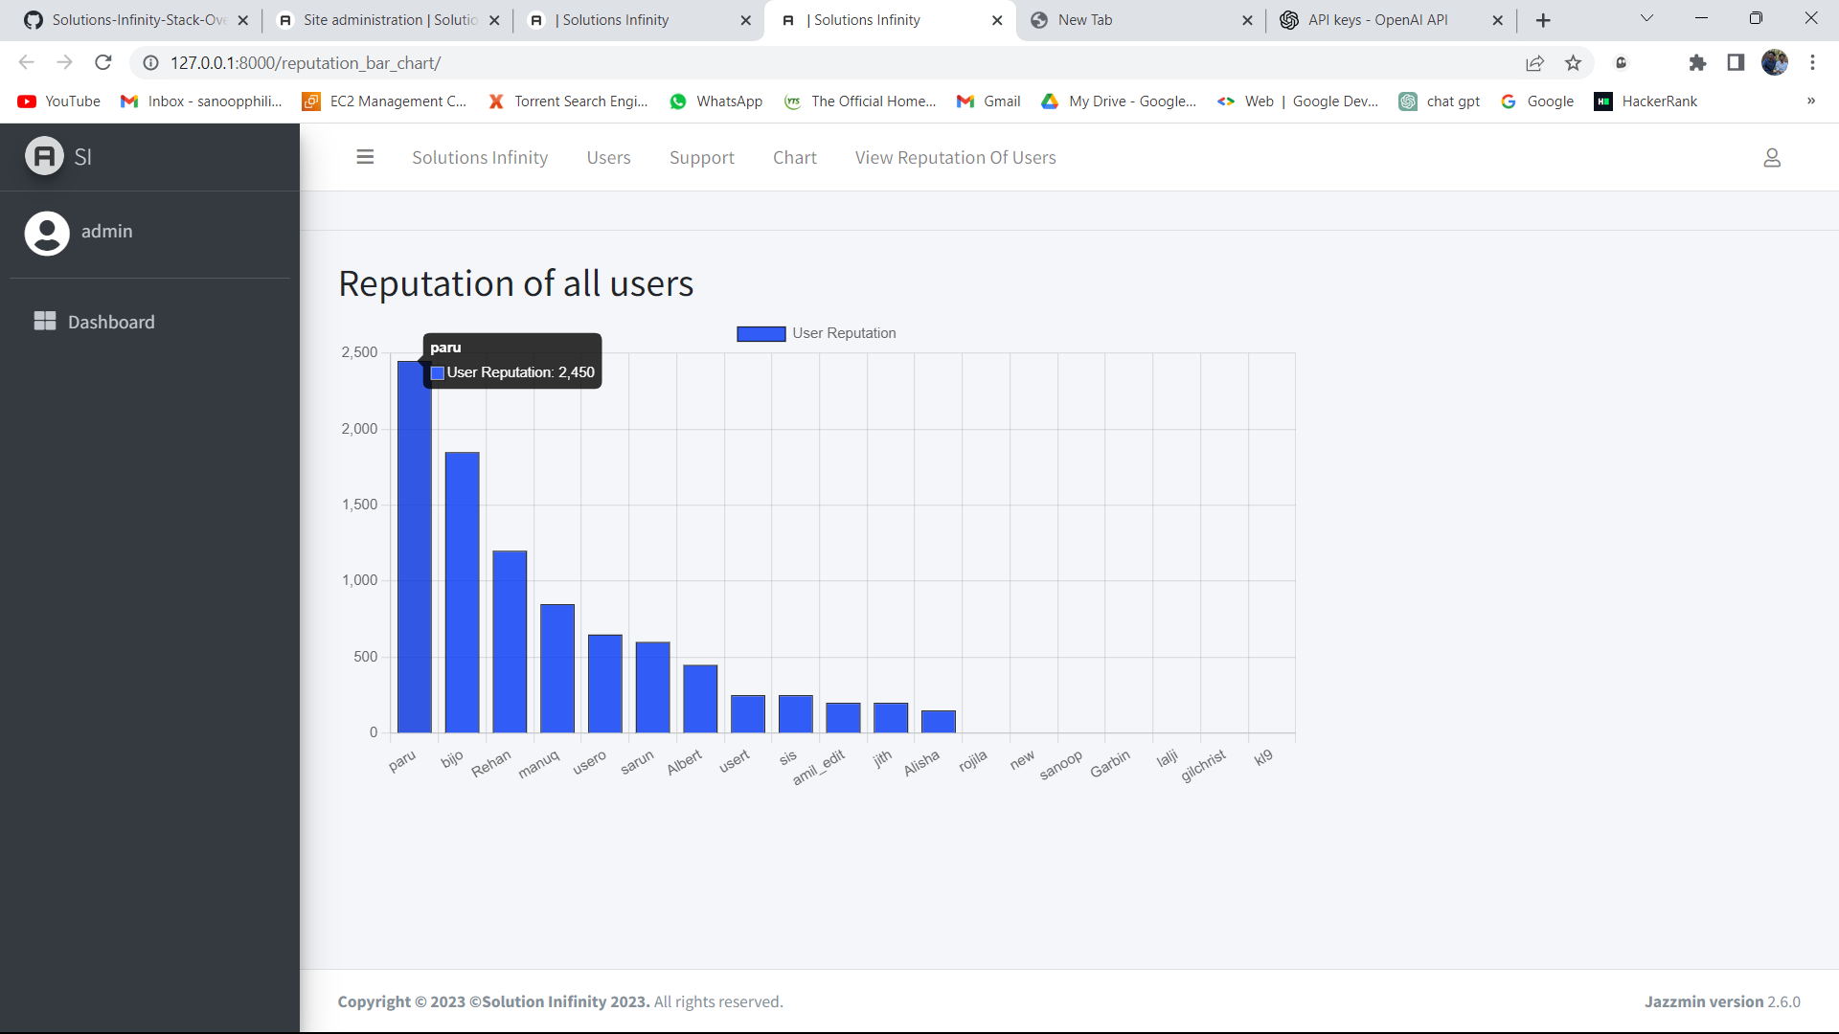
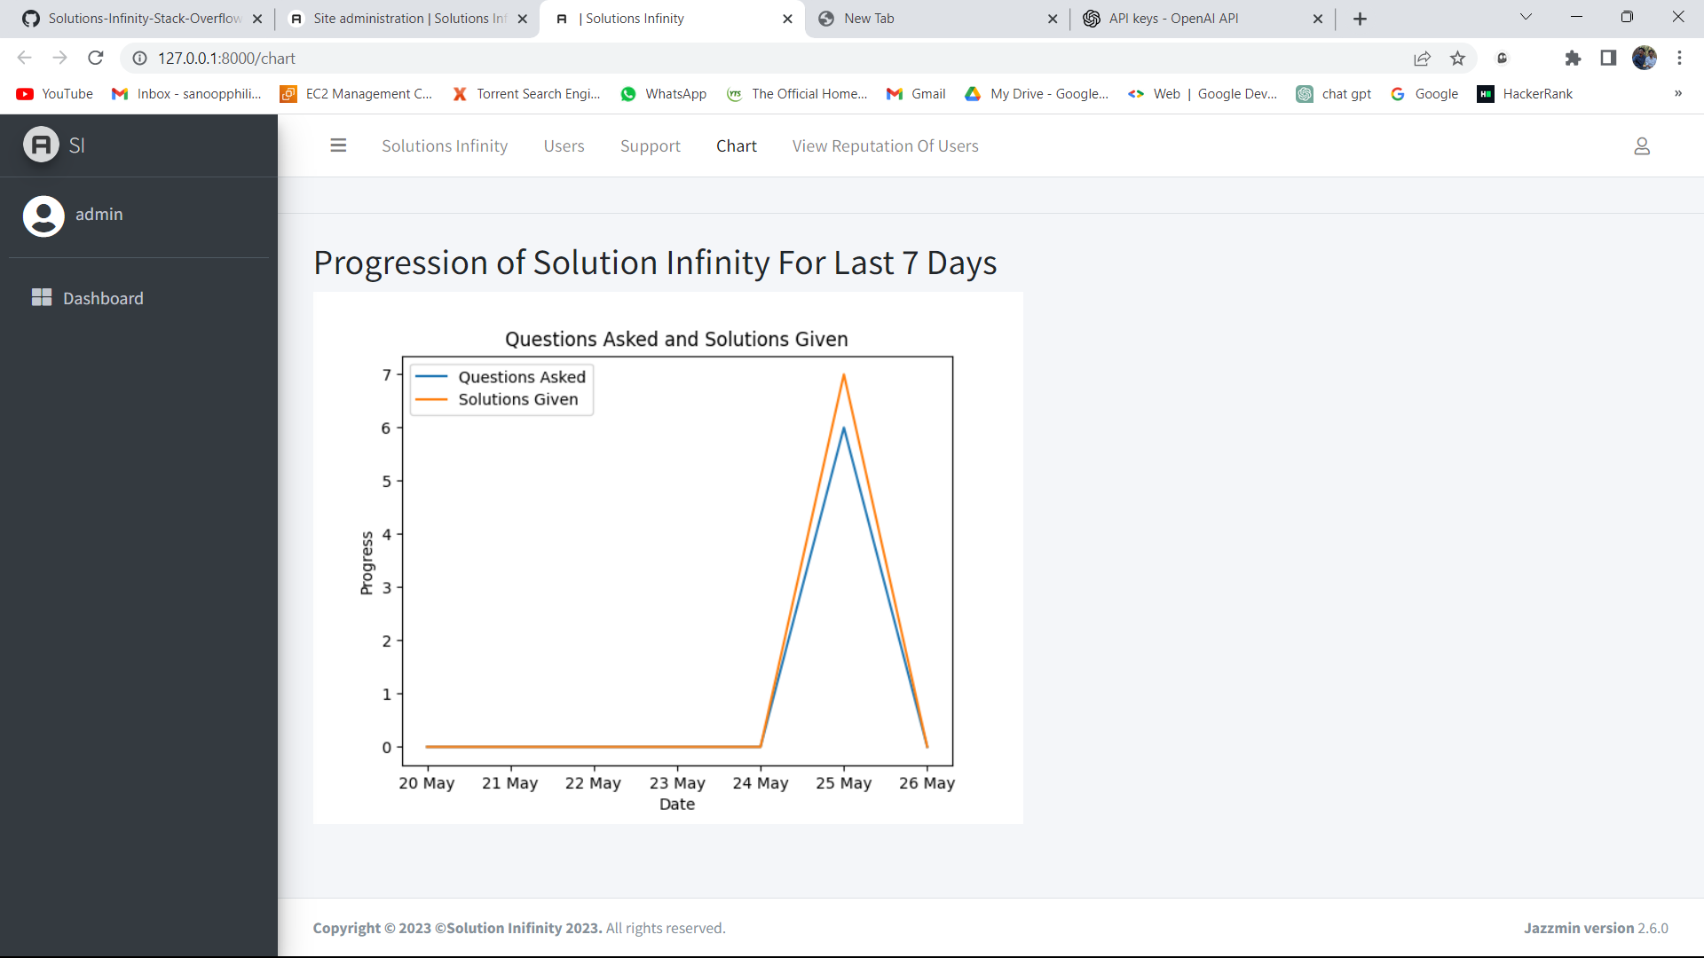
Screenshots
All users reputation can be viewed by admin.
Admin can view the Weekly progression of the system.

Slide 11
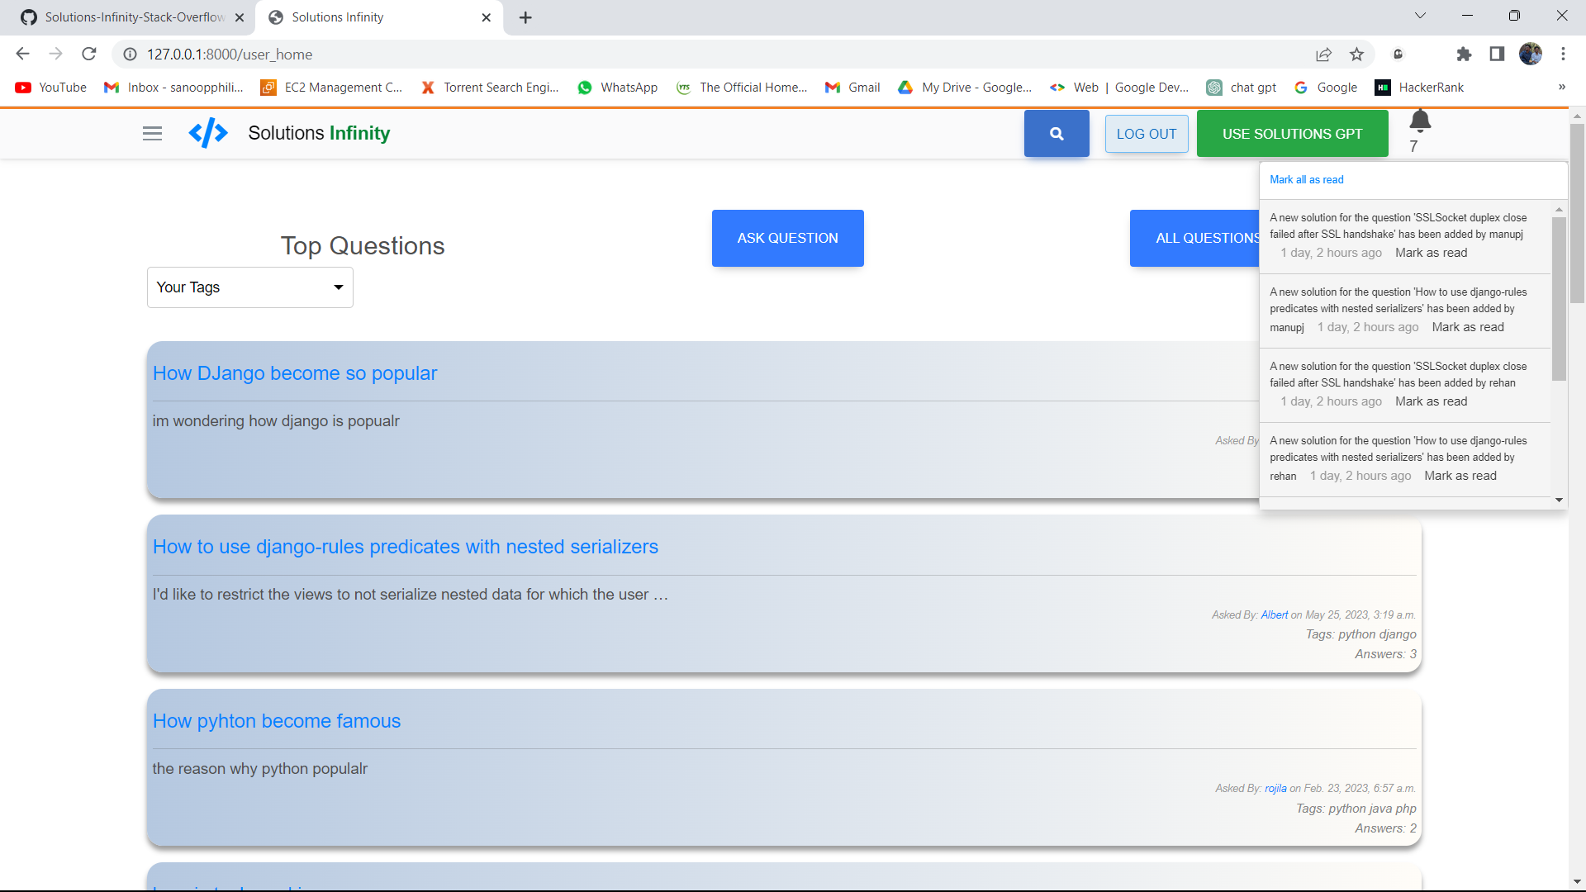
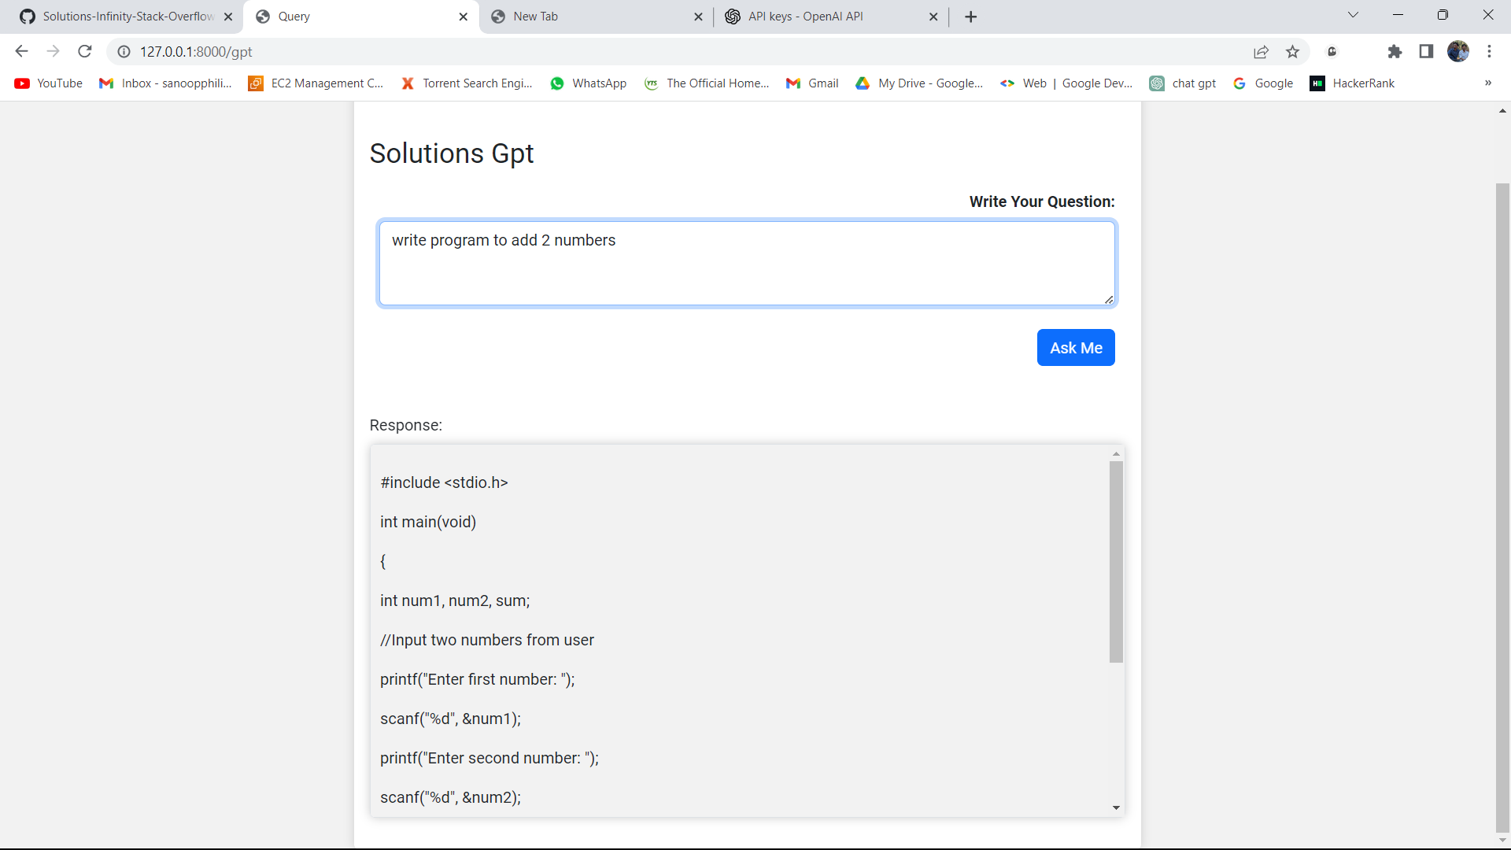
On user home page they will get notification if anyone response to their question.
Solutions Gpt can be used if user don’t get solution from
system

Slide 12
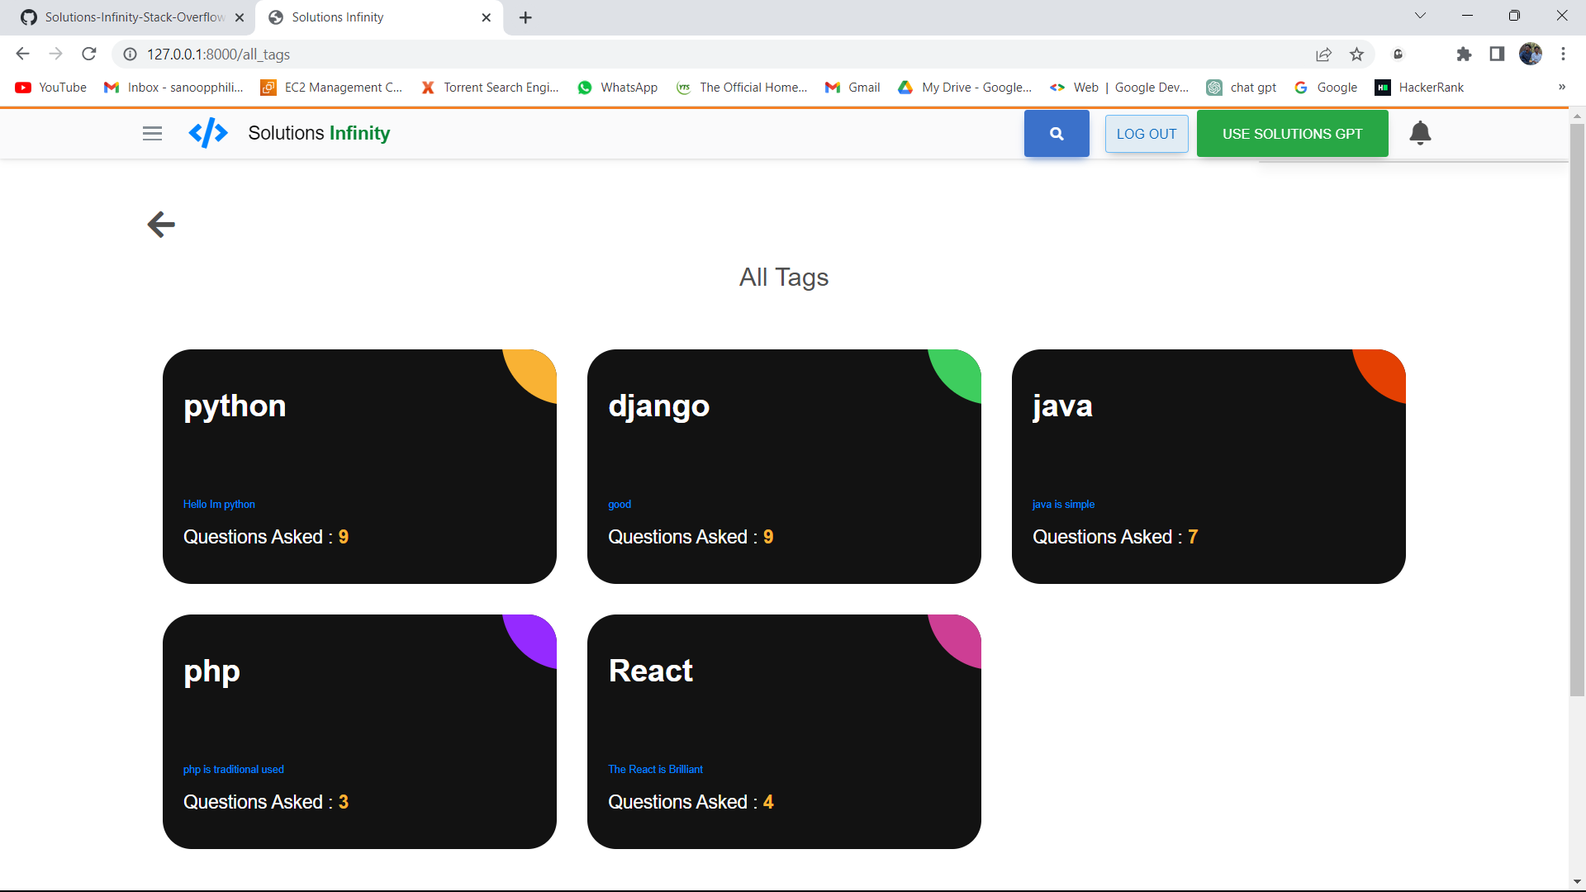
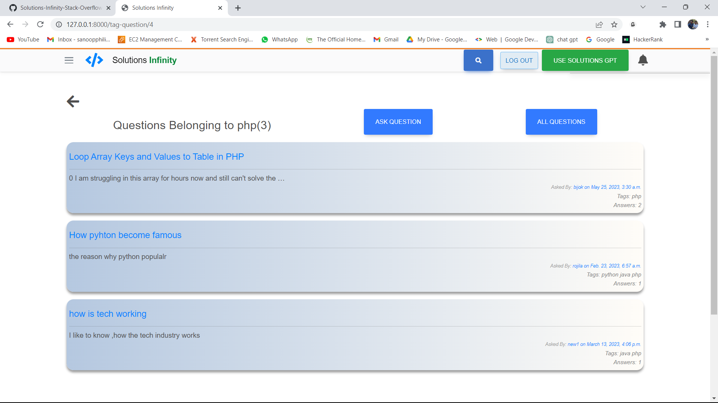
This is the question tag page where user can see all tags in system and see questions related to it.
user can view questions according to tags

Slide 13
FUTURE ENHANCEMENT
Chat option between users.
Edit question option.
Edit answer option.

Slide 14
conclusion
The proposed system has the potential l to foster a vibrant and collaborative community of developers, where knowledge is shared, problems are solved, and valuable connections are create. Constructing a Stack Overflow clone can be a great way to build a healthy community of knowledge-sharing and problem-solving. You can create a platform where users can ask questions, receive answers, and engage in discussions about programming, software development, and other technical issues by reproducing the basic operations and features of Stack Overflow.

Slide 15
references
https://stackoverflow.com/

